Slide 1
Willaura Primary School Our Garden

Slide 2
Willaura Primary School has always had teachers, parents and students interested in gardening. But by mid-2011 our garden had become overgrown and tired. It was time for a major re-vamp!
ALL of our projects have involved parents, staff, students and local community members working together. As a small rural school we are on a very tight budget, so all of our work outside is undertaken by ourselves, unless special equipment or expertise is needed. Here are some of the projects students, parents and staff have undertaken together.

Slide 3
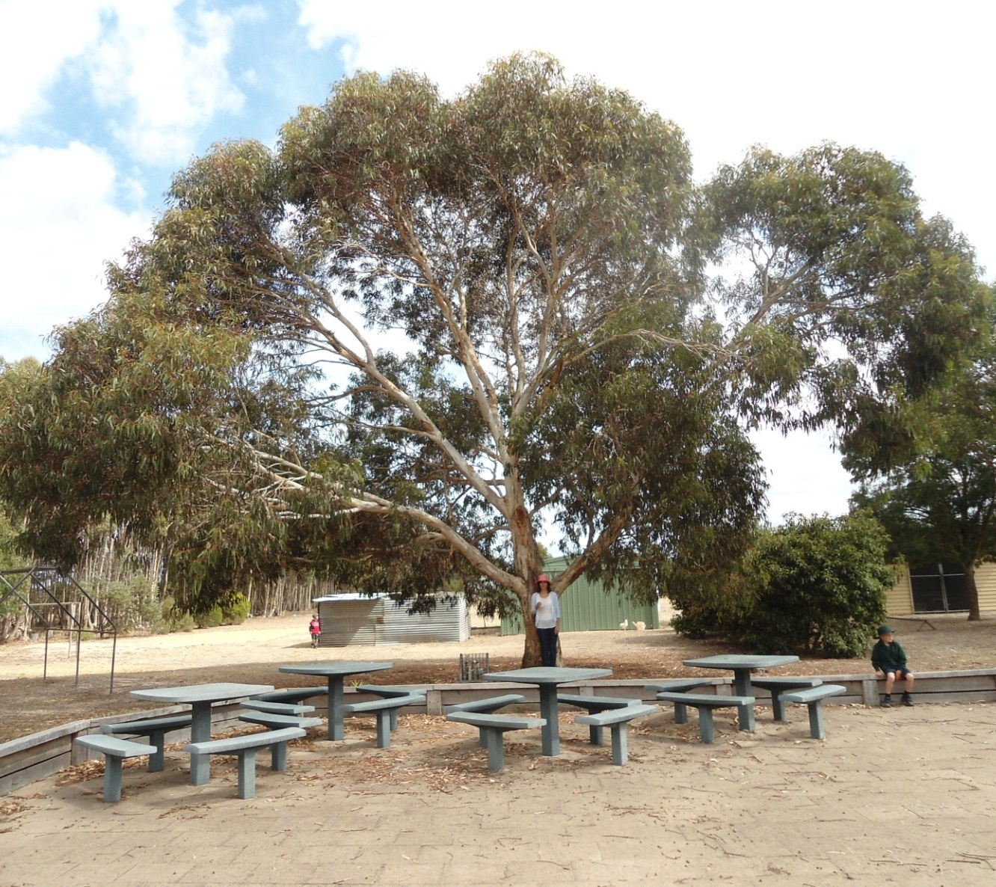
In our yard was an old gum tree. It was very beautiful, but it was also very dangerous. Over the school holidays it dropped a branch right onto the tables you can see here. It had to be removed.

Slide 4
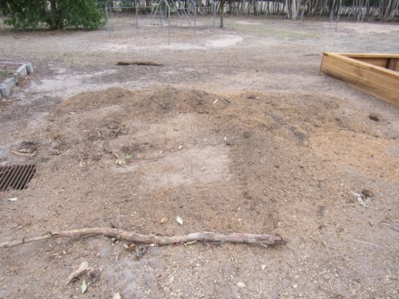
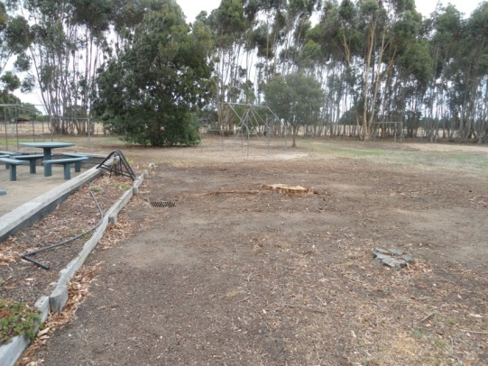
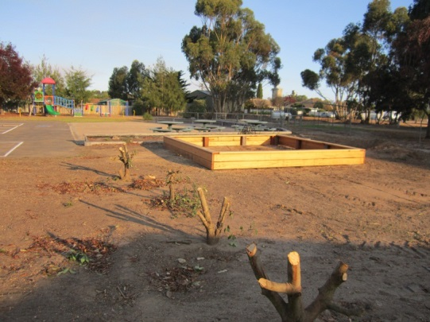
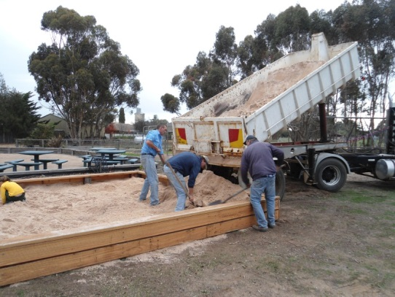
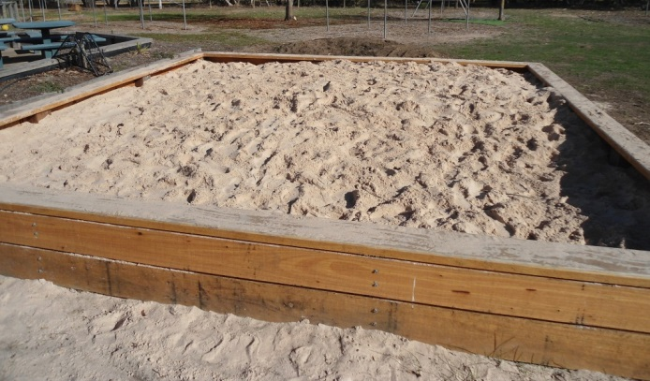
Removing the tree left a huge space.
Luckily for us we had some clever Dads who built ….
An equally HUGE sandpit ☺

Slide 5
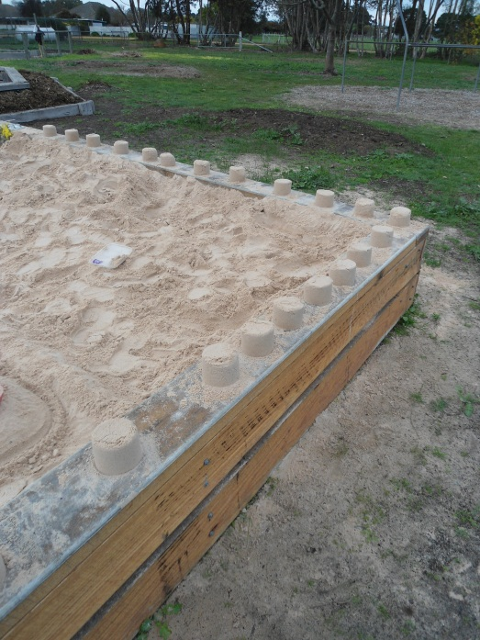
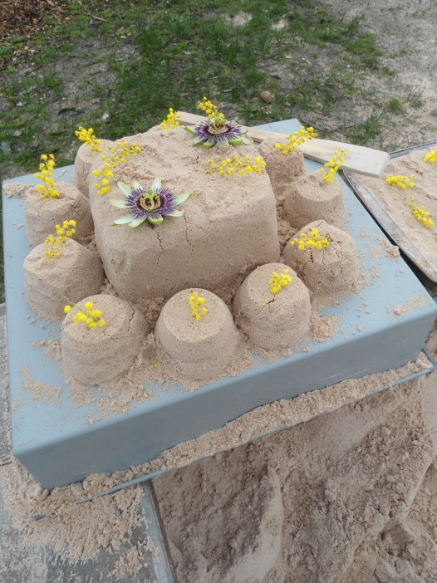
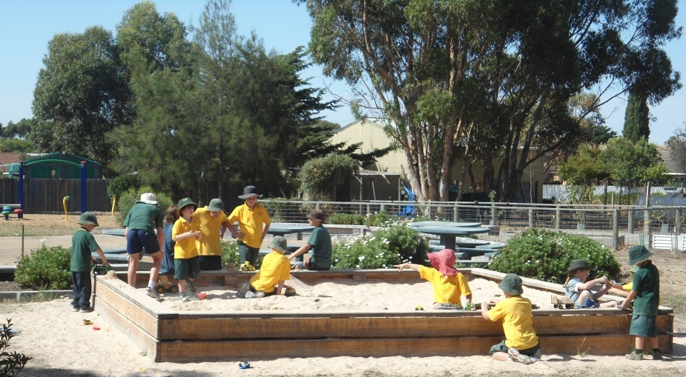
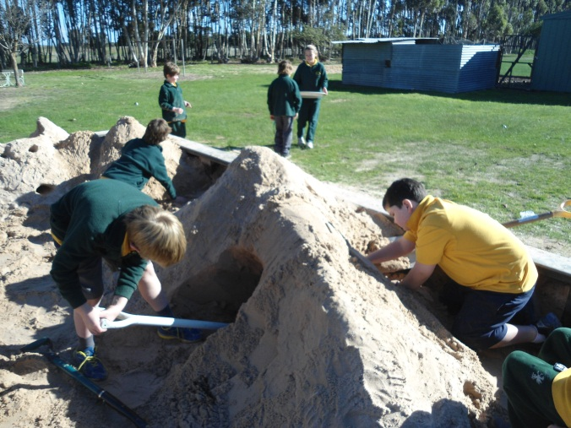
Our sandpit is now one of the most popular areas in our playground. Students dig, create, ‘cook’, build, talk, laugh and work together.

Slide 6
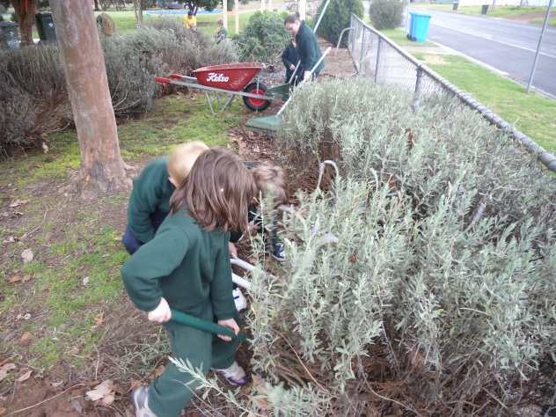
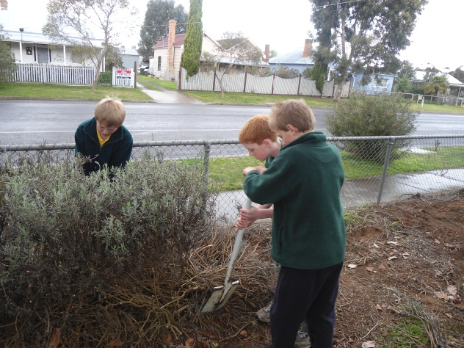
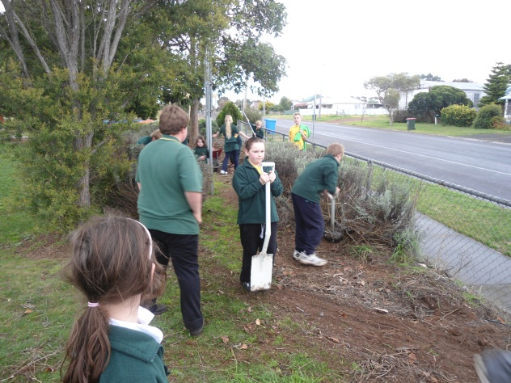
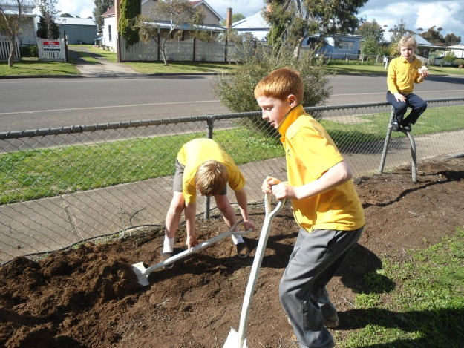
A major new development was our front fence area. Students removed the old, over-grown lavender hedge. Everyone driving past watched keenly. The soil was hard and dry and students worked hard to get it ready for planting.

Slide 7
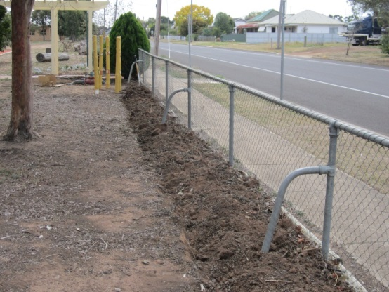
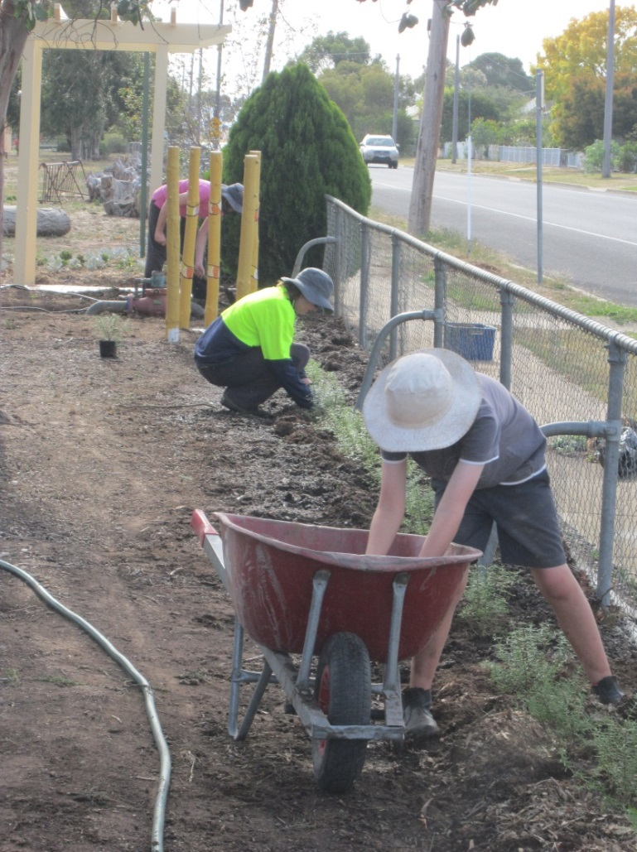
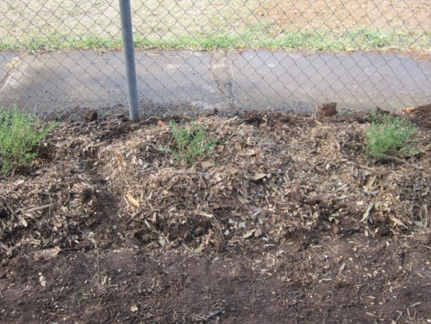
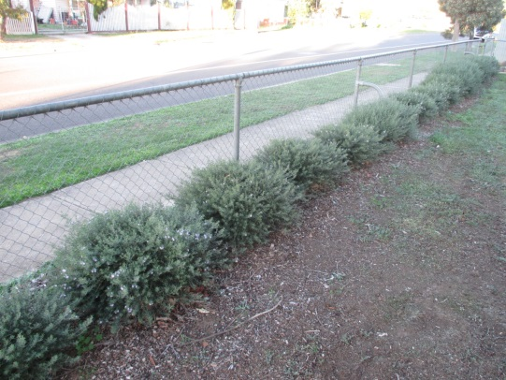
Thank you to Scott (Yr 5) and parents Kelly and Casey who came in over the weekend to dig, plant, water and mulch. The new hedge is growing beautifully!

Slide 8
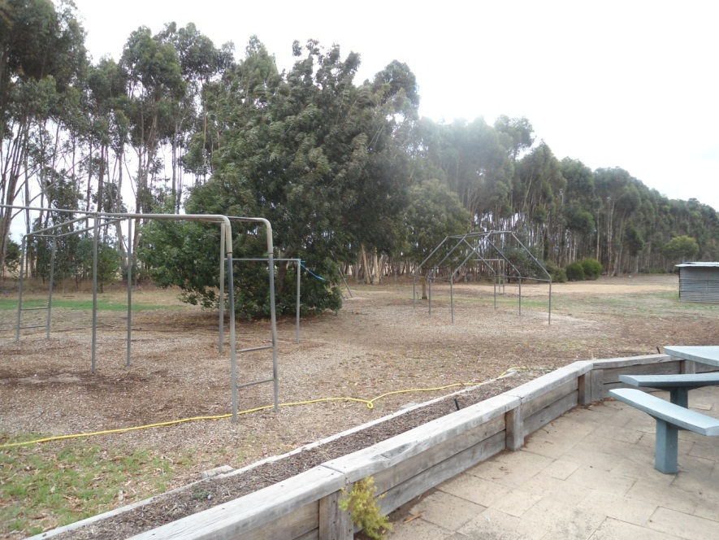
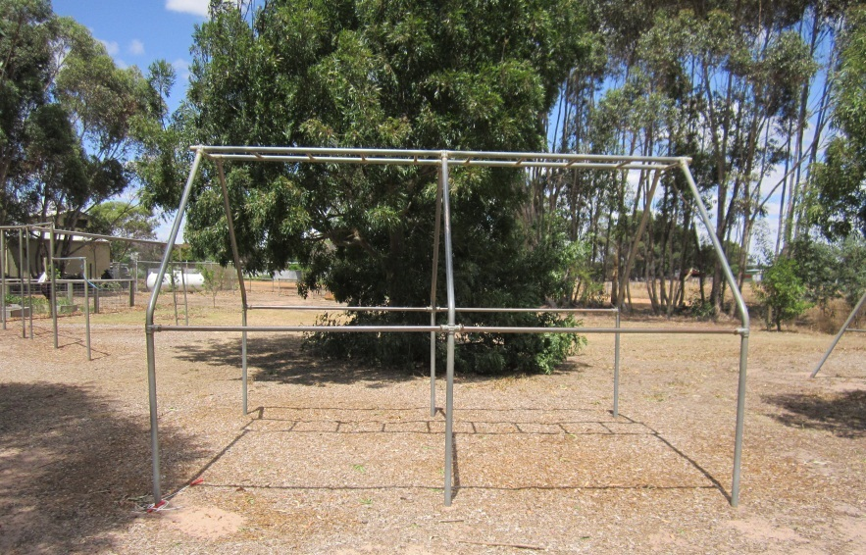
We have also improved our grounds facilities this year by re-vamping our playground. We had some old pieces that were broken and others were so far apart we couldn’t edge them and spread soft fall so they couldn’t be used.
So we thought long and hard….and came up with a plan!

Slide 9
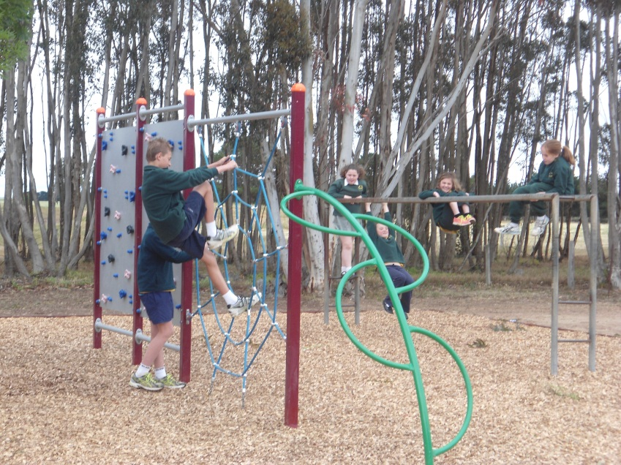
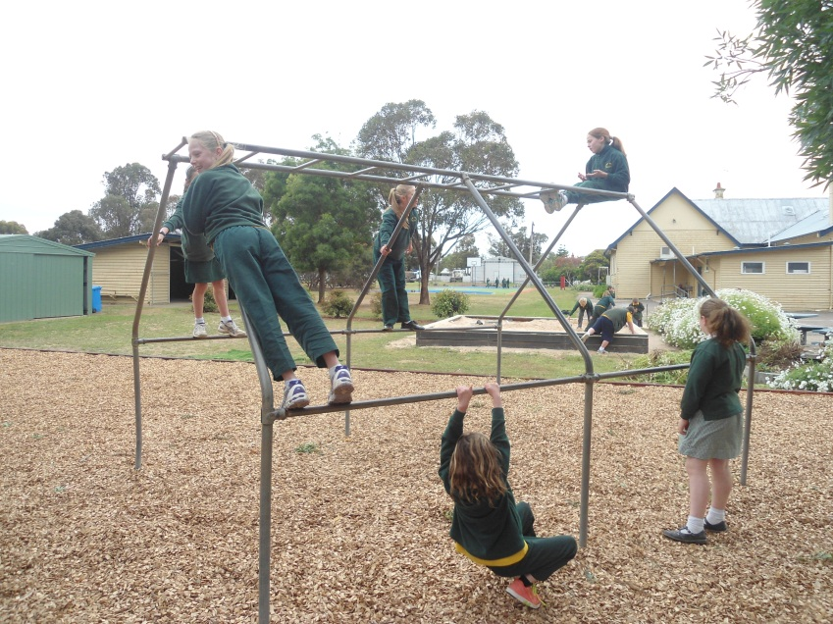
Our Dads removed some playground pieces. The newest piece was relocated.
With new edging and soft fall we had a new play area for senior students!

Slide 10
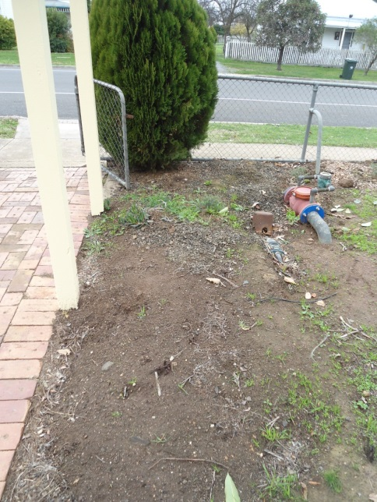
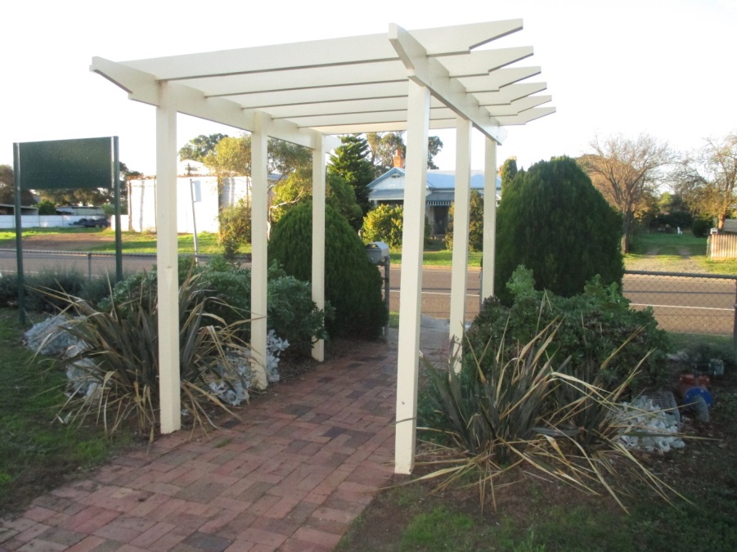
Another new development has been the front garden beds on either side of the gate. We had a huge flax plant at school so we dug it up and divided it, making new plants for this area. The other plants came free from local gardeners as cuttings.
The pergola was painted and the new plants have grown beautifully. They are so hardy they do not need to be watered.

Slide 11
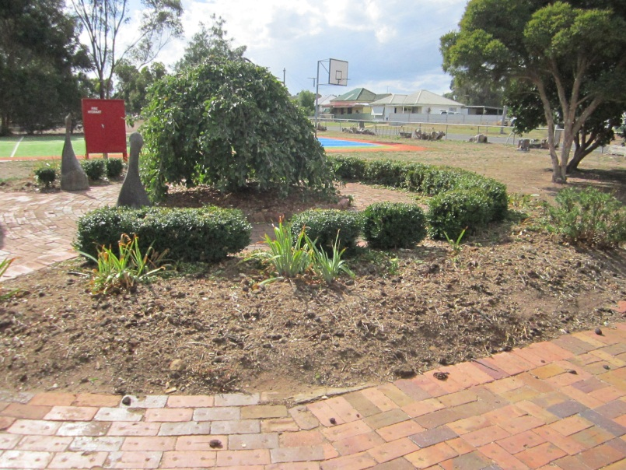
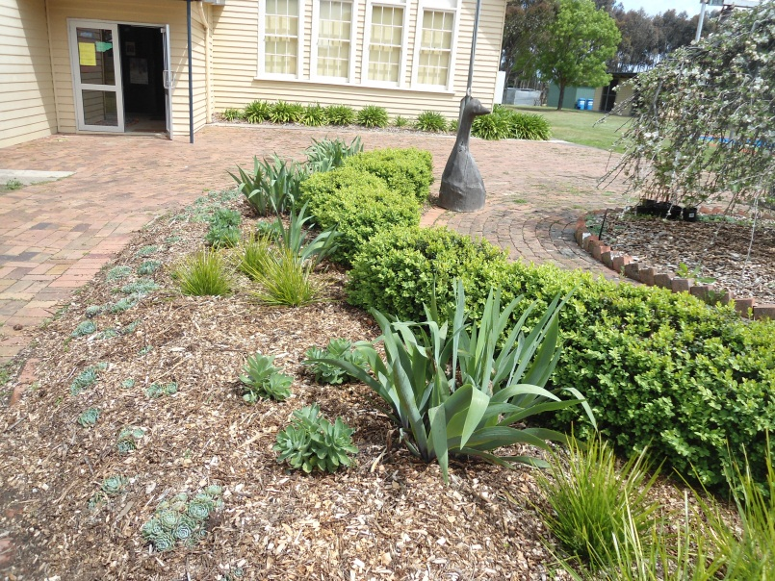
We also replanted the circular bed in the front garden. We removed old plants, and with deliveries of manure and straw from school families we improved the soil. We planted hardy perennials and the garden is thriving.

Slide 12
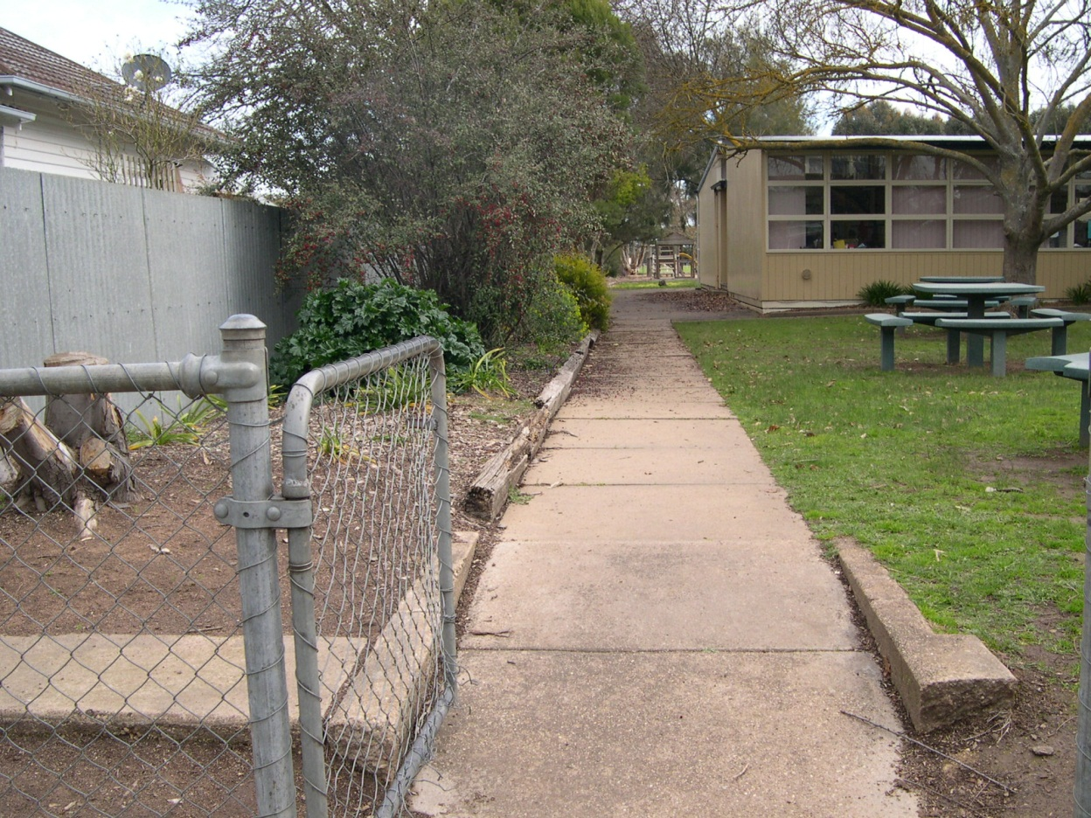
Another major project has been the side garden. From the front gate it looked overgrown in parts, bare in other parts and just tired. It was time for a makeover!

Slide 13
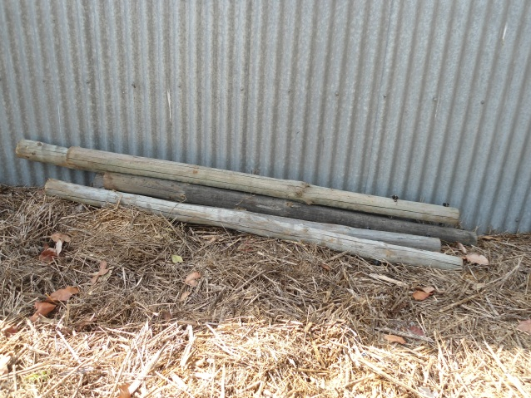
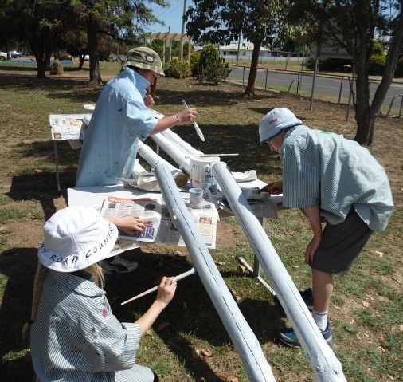
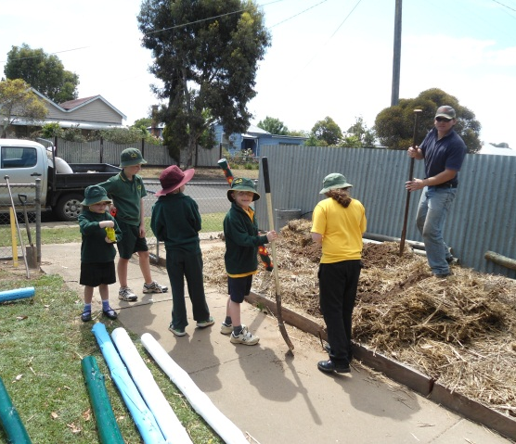
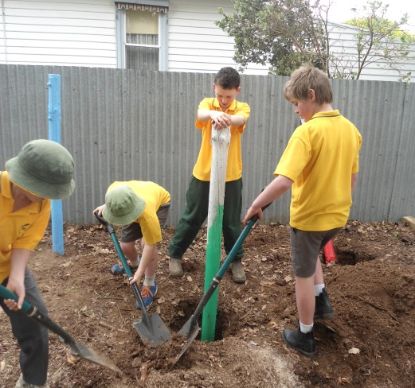
We bought some second-hand pine poles from a local vineyard. We undercoated and painted them. Matt (a Dad) donated timber and edged the garden bed for us. Pat (a Dad – again!) put the first poles in. Students watched him closely and put the rest in themselves.

Slide 14
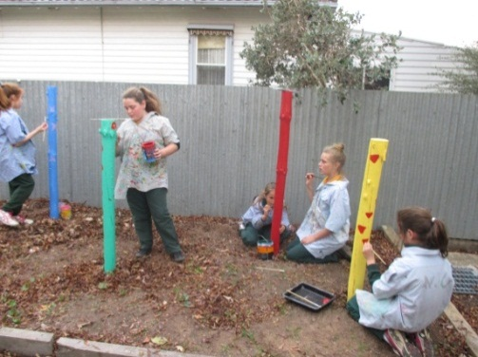
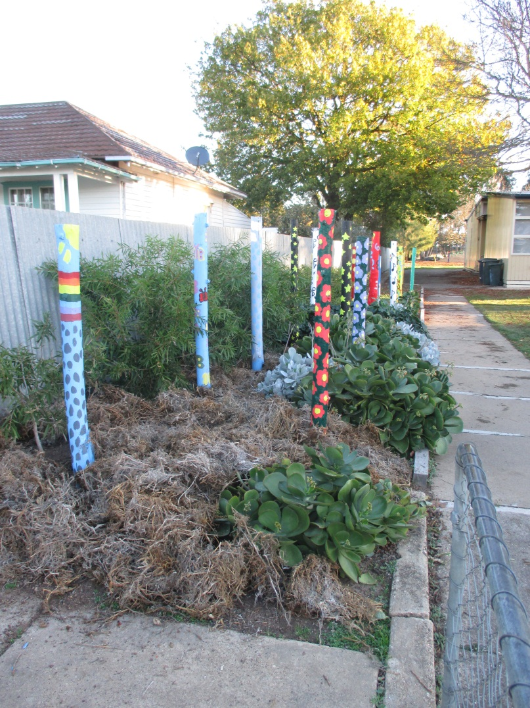
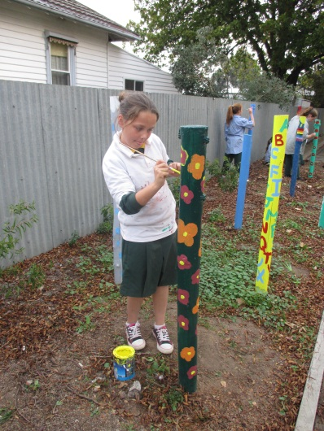
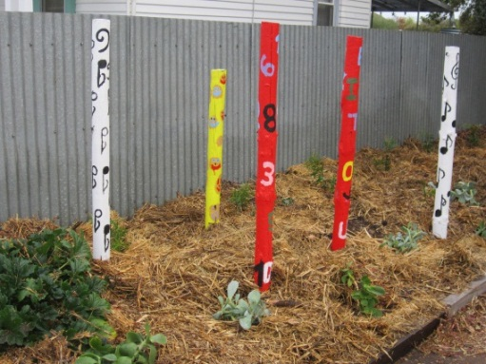
We painted the poles with different designs: rainbows, raindrops, numbers, letters, fruit, music notes, stars, flowers and insects. We planted a bottlebrush hedge to attract birds and filled the bed with drought tolerant succulents.

Slide 15
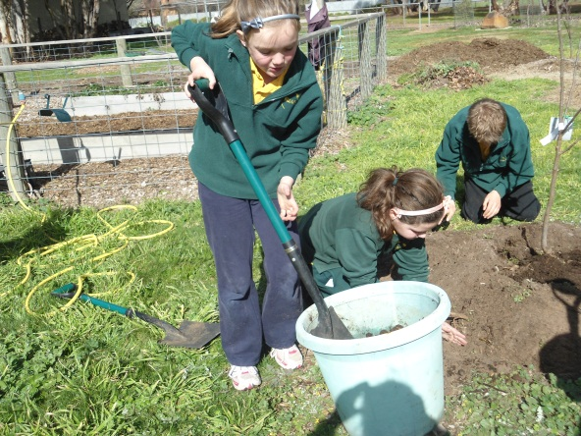
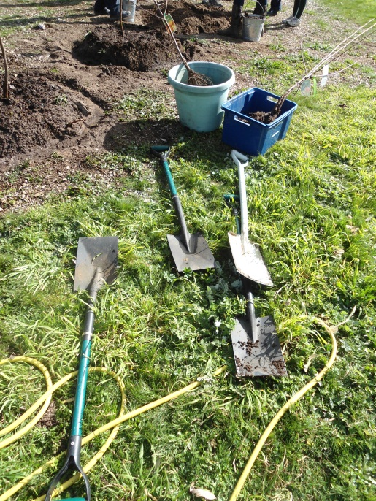
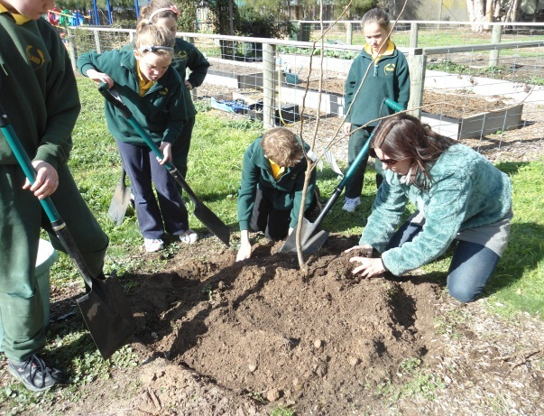
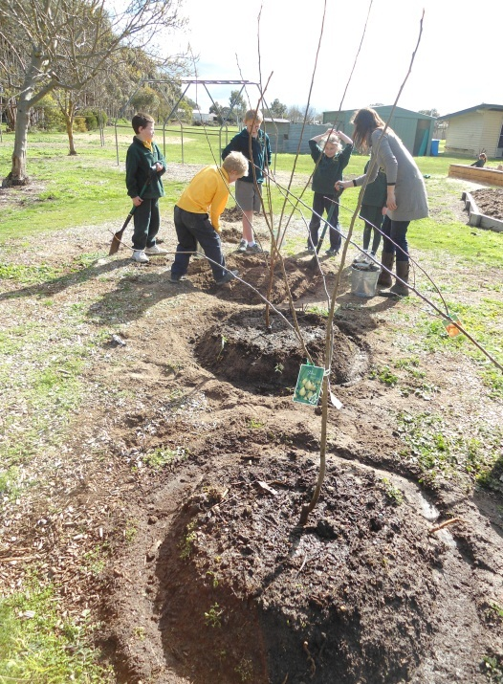
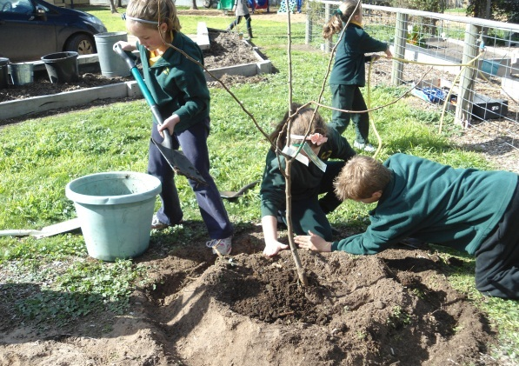
We are also working hard in our vegetable garden. We have planted a small orchard.

Slide 16
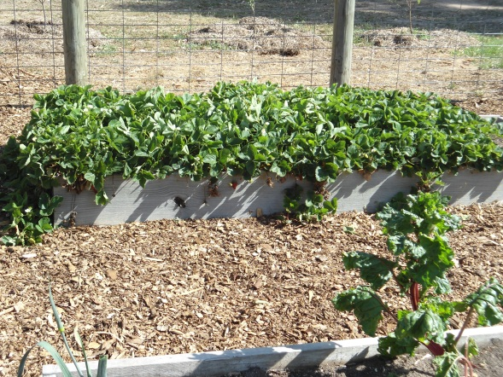
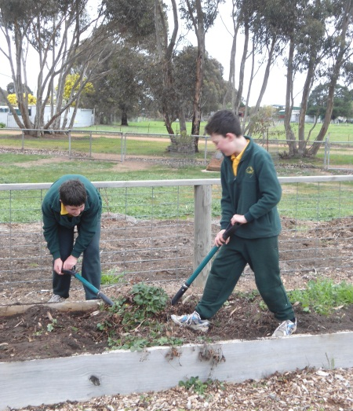
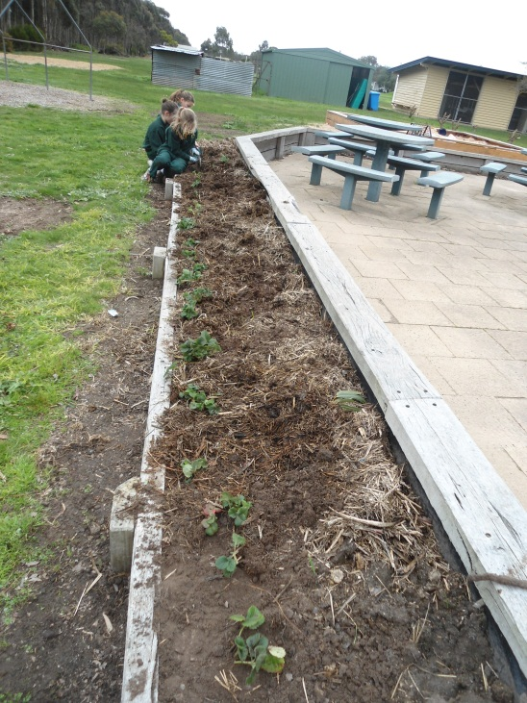
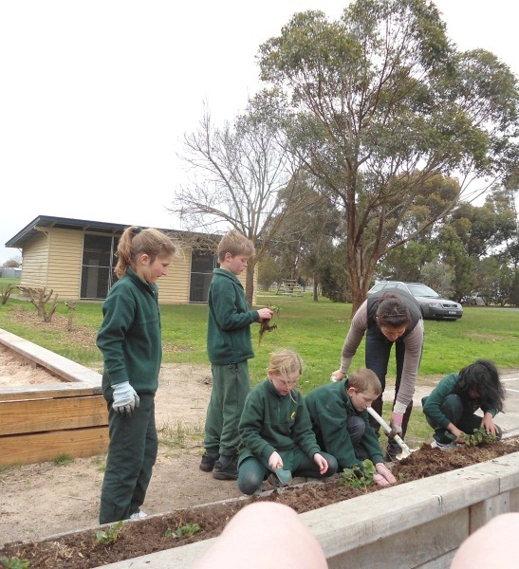
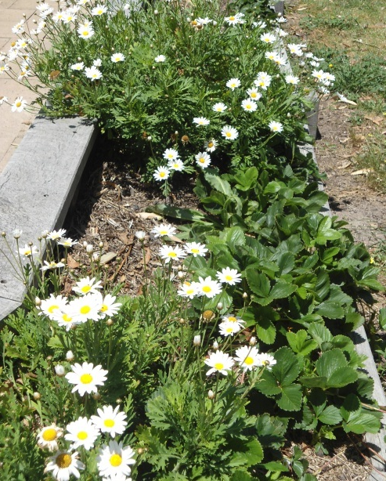
We divided up our crowded bed of strawberries and planted them out.

Slide 17
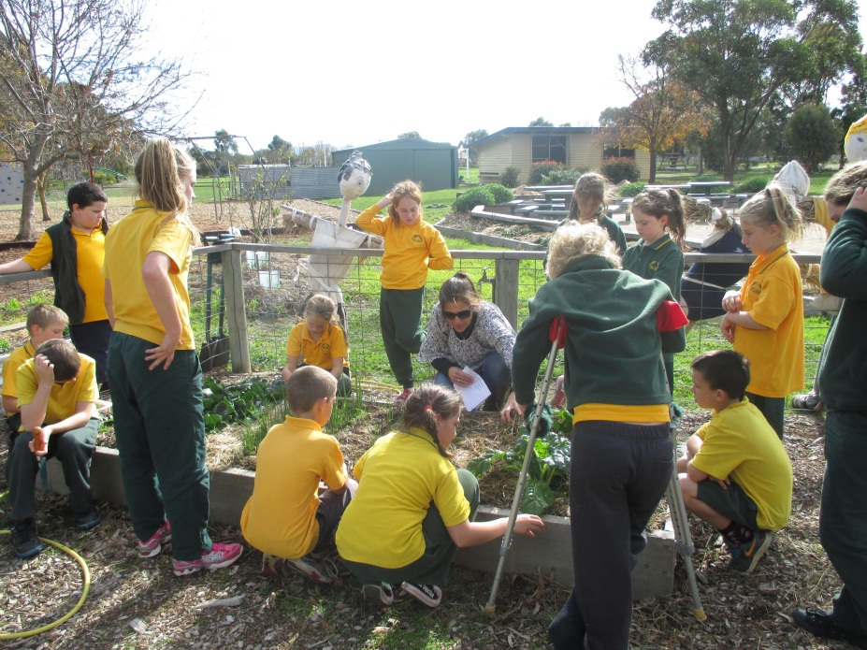
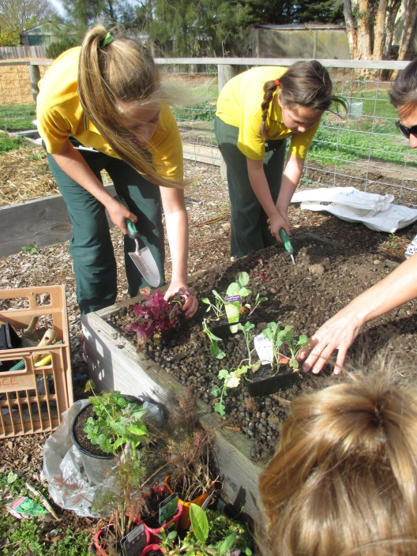
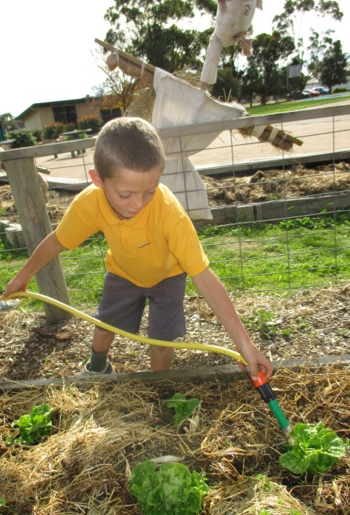
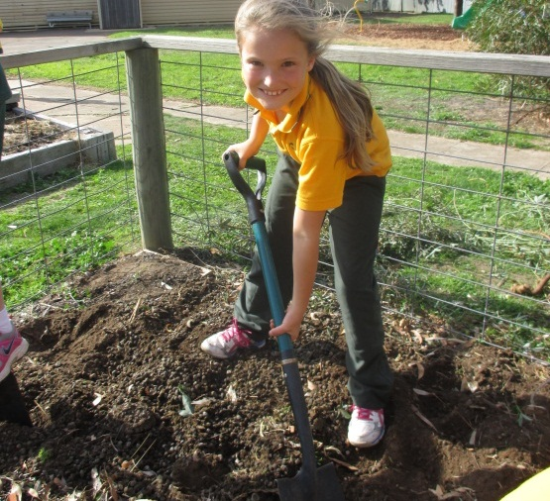
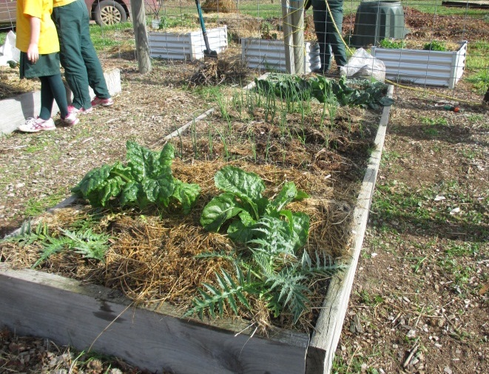
And we have planted LOTS of vegetables!

Slide 18
To keep our garden looking good we have a gardening roster where each family comes in once a term to rake, sweep and weed. Parents come in for working bees for special jobs, for example, cutting back the over-grown photinias. Students mulch, spread bark chips, rake and tidy. To keep things looking good sometimes we even go outside the yard to work!

Slide 19
BEFORE
AFTER
These pairs of photos were all taken in the same place. It is great to look at what we have achieved.

Slide 20
We are very proud of our school garden. It has been a team effort with parents, teachers and students all working incredibly hard together. There is still plenty to do, but it is good to stop and reflect on how much we have achieved. We think it looks pretty amazing and we hope you agree!

